Slide 1


Slide 2

PROJECT MEMBER
SAMEER AHMAD
RAVINDER
MUDAVATH
Qualification : B.Sc. (PSM)
Pass out year : 2020
Experience : Fresher
Batch : 147
Qualification : B.Sc. (MSCS)
Pass out year : 2020
Experience : Fresher
Batch : 147

Slide 3

Bitcoin Cryptocurrency
2013-2022 HISTORY

Slide 4

Data Analysis
Project : Web Scraping
Domain : Cryptocurrency
Title : Bitcoin History Analysis

Slide 5

About Bitcoin
Satoshi Nakamoto
In 2008, Bitcoin was Invented by Satoshi Nakamoto in Japan.
The currency began use in 2009.
$1(BTC)=₹1,606,218.67(Indian rupees).
Amit Bhardwaj had been started bitcoin in India.
103 countries are using bitcoin in the world.

Slide 6
Libraries used during web scraping
Beautiful soup
Requests
Matplotlib
Beautiful Soup is a Python package for parsing HTML and XML documents
Requests will allow you to send HTTP requests using Python.
Matplotlib is a comprehensive library for creating static, animated, and interactive visualizations in Python.
Numpy
Pandas
Seaborn
Numpy is a Python library used for working with arrays
Pandas is a Python library for data analysis.
Seaborn is a library for making statistical graphics in Python.

Slide 7
INTRODUCTION

Slide 8
We got some problem statement on bitcoin cryptocurrency. To solve problem…….
We Imported all the required libraries.
Sent request to targeted website to get URL, we got status code 200 to move forward.
By using Beautiful soup we got html documents, then scraped our required data according to problem statement.
We created Dataframe of scraped data, then stored it into csv file.
Worked on cleaning process.
Then worked on solving analytical problem statements.
We plotted statistical graphs and concluded our result .

Slide 9
Contents
01
02
03
Problem Statement
Data Scraping
Data Cleaning
04
05
Exploratory Data Analysis (EDA)
Conclusion

Slide 10
01
Problem Statement

Slide 11
Bitcoin’s last 10 years of history.
Condition of bitcoin during first wave and second wave of covid-19.
The proportionality of price of bitcoin on the other variables.
Maximum no. of times the price of Bitcoin located.
Total Circulating supply of bitcoin till 2022.
Highest price of bitcoin in the history .

Slide 12
02
Data Scraping

Slide 13
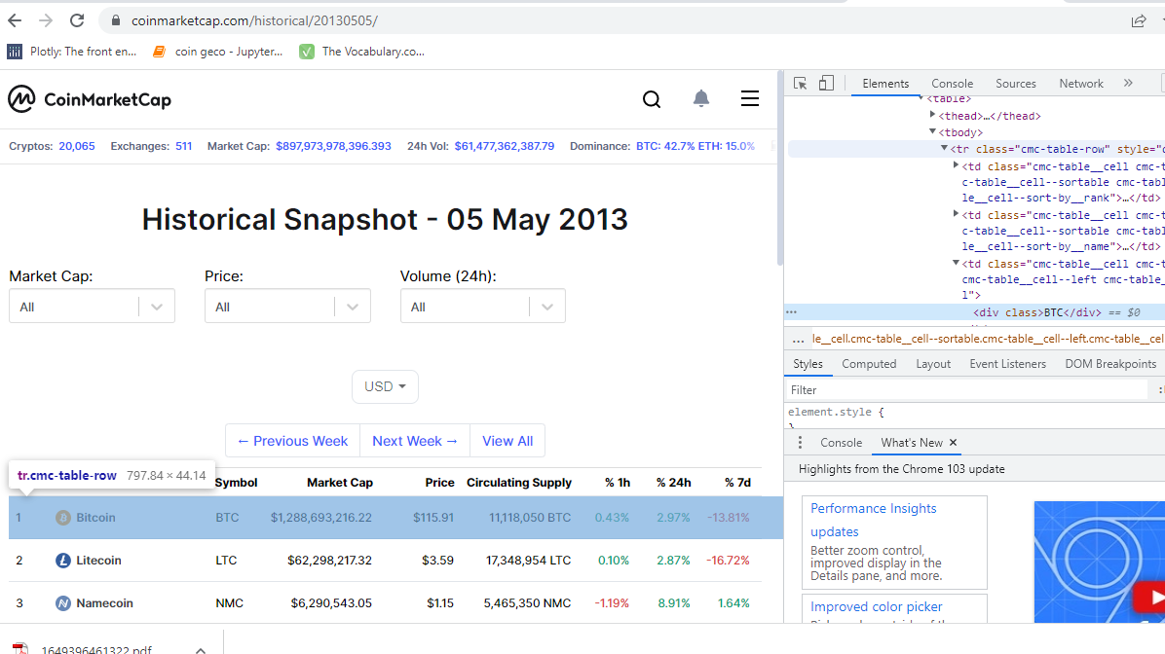
Website : CoinMarketCap.com
Data Extracting by inspecting

Slide 14
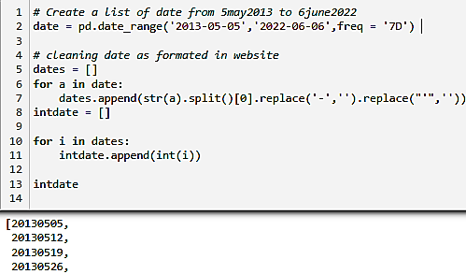
Challenges During Scrapping Data
Created a Date list with the frequency of 7 days(2013-2022).
Then formatted Date list in the form of website date format .
URL = 'https://coinmarketcap.com/historical/{}/'.format(str(i))
Finding classes of title when inspecting.

Slide 15
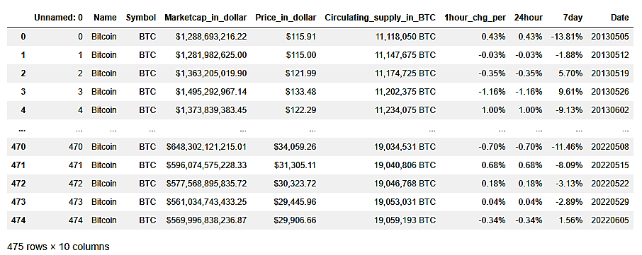
Scrapped Data (Raw Data)

Slide 16
03
Section C
Data Cleaning

Slide 17
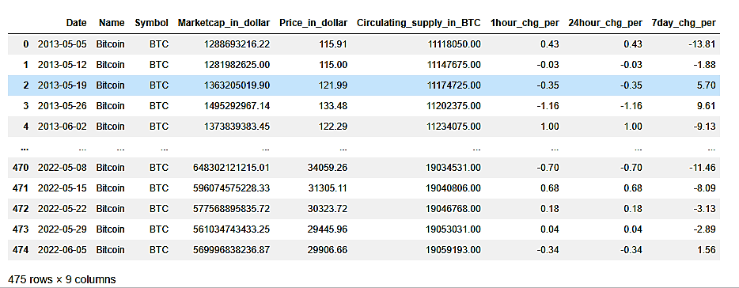
Cleaned Data

Slide 18
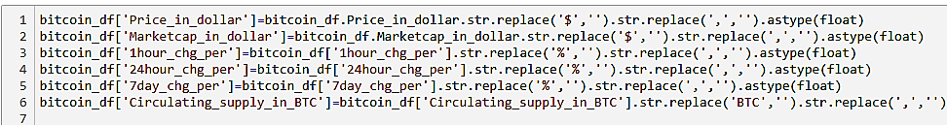
Challenges During Cleaning Data
Removed symbols like '$' , '%’, ‘commas’ and ‘BTC’.
Changed Data type into float and integer respectively.
Data manipulation.
We have changed the column name by mentioning there unit like percent, dollar and BTC respectively.
.

Slide 19
Raw Data v/s Clean Data

Slide 20
04
Exploratory Data Analysis (EDA)

Slide 21


Slide 22
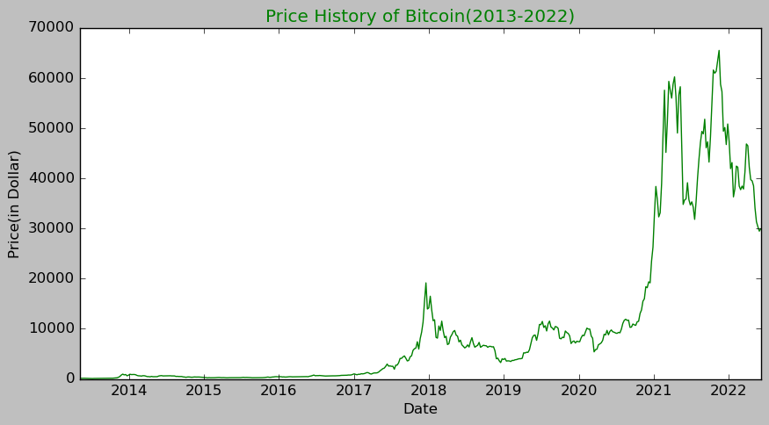
Bitcoin’s last 10 years of history.
Insights:-
At the end of 2017 price increased up to $20,000.
At end of 2020 and starting of 2021 price suddenly increasing up to $60,000.
Between 2021-2022 price increased up to $65,000.

Slide 23
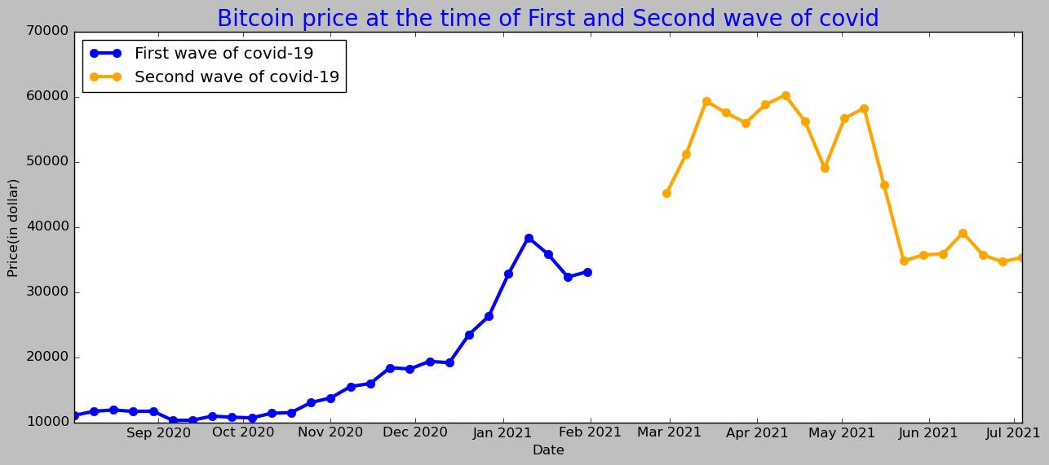
At the time of coronavirus pandemic, price of bitcoin in the first and the second wave of covid-19.
Insights
When the first wave of covid in the world was started the price of bitcoin was $11,053.61 and at the ending of wave was $33,114.31, by calculating hike percentage of bitcoin price we got 200%.
When the second wave of covid in the world was started the price of bitcoin was $45,137.77 and after 3 months the price reached to $60,204.96, by calculating hike percentage of bitcoin price we got 80%.

Slide 24
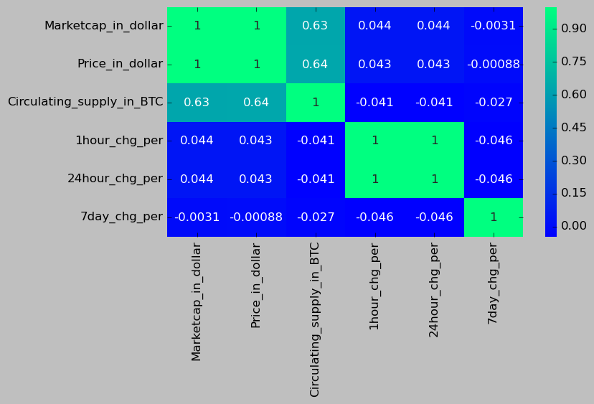
The proportionality of price of bitcoin on the other variables.
Insights
Price of bitcoin is directly proportional to the market cap and circulating supply.
1hour percent change is directly proportional to the 24hour percent change.
Notes:
265393

Slide 25
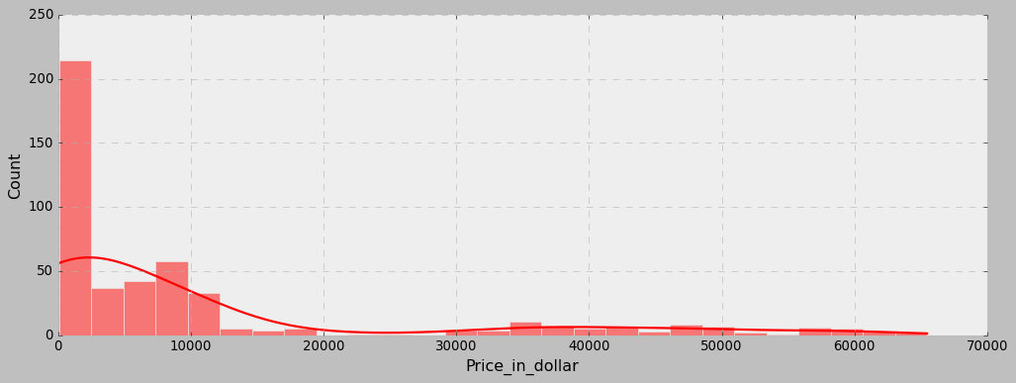
Maximum no. of times the price of Bitcoin located.
Insights:-
Maximum number of times the price of Bitcoin is between $0 to $2000

Slide 26
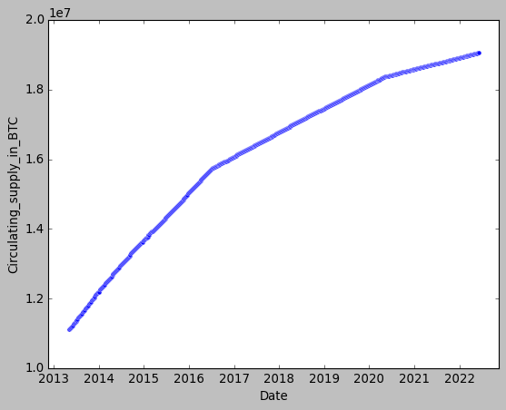
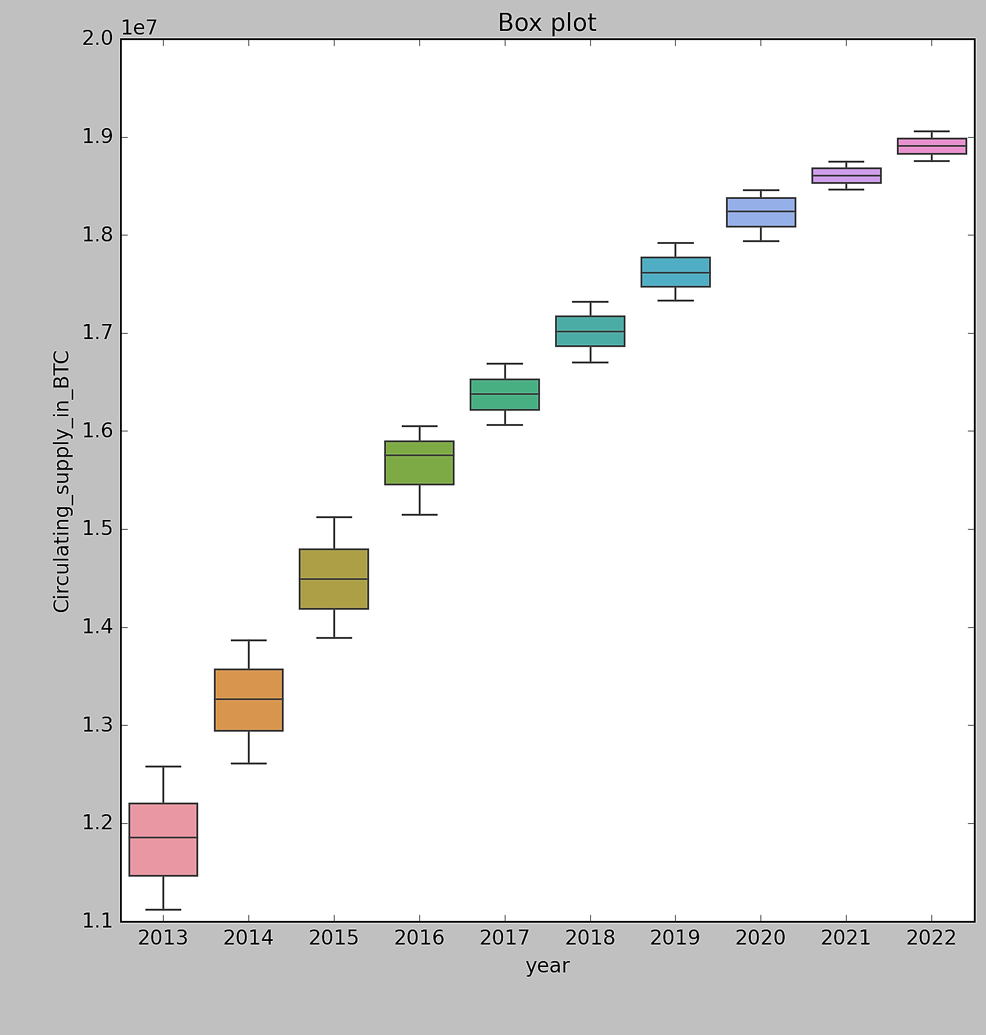
Total Circulating supply of bitcoin till 2022.
Insights
As of June 2022, approximately 19.07 million Bitcoins are in circulation.
In 2013 price was less so circulating supply was more but now price is high so circulating
Supply is less..

Slide 27
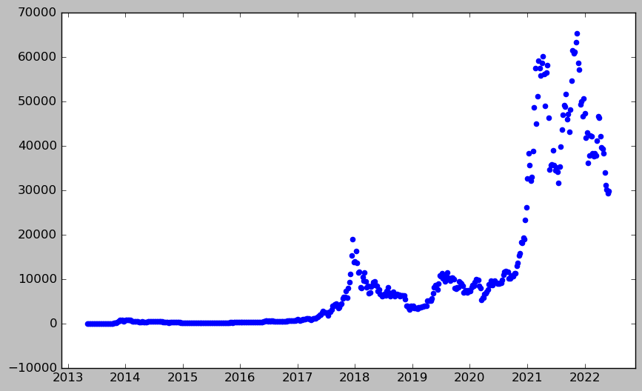
Highest price of bitcoin in the history.
Insights
:- As we can see that the highest peak of the bitcoin is at the ending of 2021 which is approximately $65,000.

Slide 28
05
Section E
Conclusion

Slide 29
Conclusion
Bitcoin Price in 2013:- In 2013, price range of bitcoin was $13 - $1,100, this was the strongest year in Bitcoin price history in terms of percentage gains. The cryptocurrency saw gains of 6,600%.
Bitcoin Price in 2017:- The Bitcoin price in 2017 breached the $1,100 𝑚𝑎𝑟𝑘 𝑖𝑛 𝐽𝑎𝑛𝑢𝑎𝑟𝑦. By December, the price had soared to nearly $20,000. That’s a 20x rise in less than 12 months.
Bitcoin Price in 2020:- By December 2020 during the coronavirus pandemic, Bitcoin’s price had increased by over 300% since January. The year ended at a price of about $29,374 — the highest it had ever been.
Bitcoin price in 2021 to Present :- Bitcoin doubled its value in 2021, but in January 2022 saw a big drop that erased almost all of the previous year’s gains. We saw Bitcoin skyrocket to an all-time high over 64,000 in the first half of 2021, then just as quickly fall back below 30,000 in mid of 2021. Bitcoin hit another all-time high over $68,000 in November, but by January 2022 had dropped back below 35,000.

Slide 30


